Slide 1



Death by Data
An Analysis of Death Row Execution Data
Team Ravenclaw

Slide 2
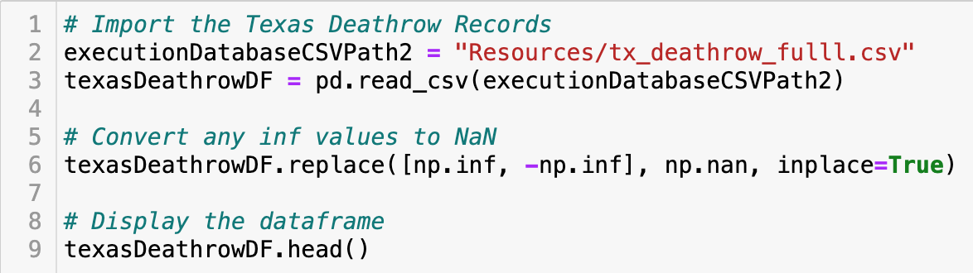
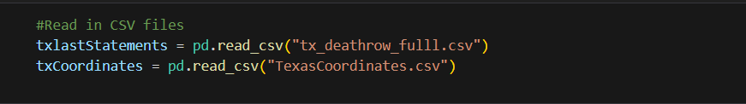
The ETL Process: Extract
We used 3 datasets for this project. One from Kaggle, the Death Penalty Information Center (DPIC), and data.texas.gov

Slide 3

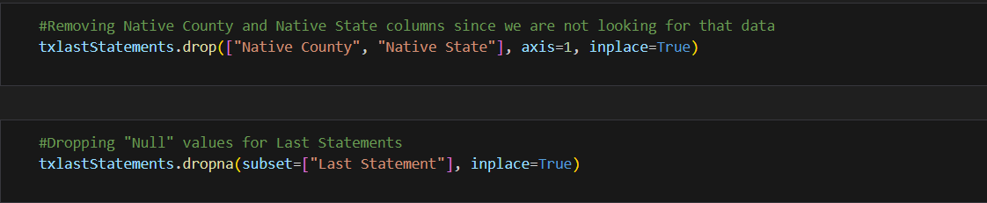
The ETL Process: Transform
We had to merge our ‘Last Statements’ dataset to bring in coordinate properties. This is how we built the geoJSON
Removing unnecessary columns and null values

Slide 4
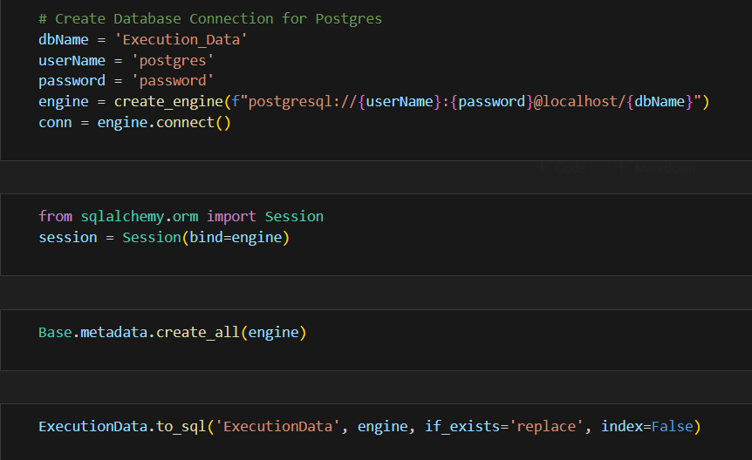
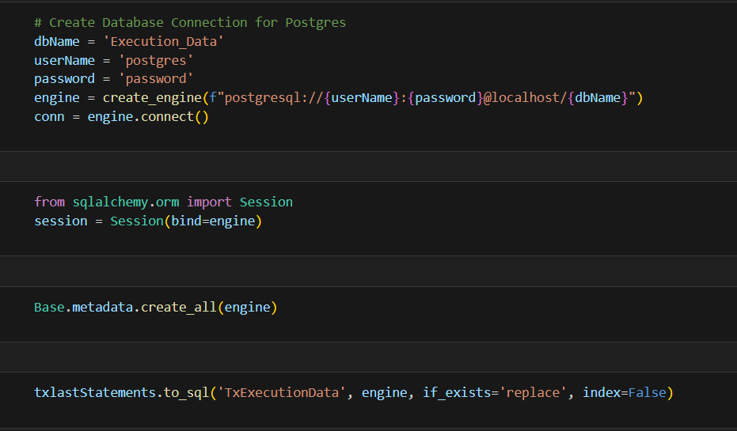
The ETL Process: Load
We used PostgreSQL to load our data because all our data is relational

Slide 5
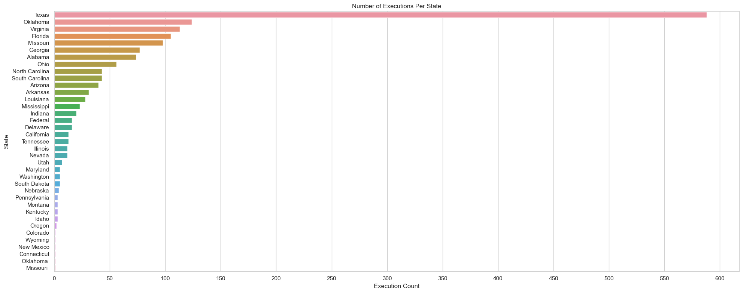
Number of Executions Per State
T-9. North Carolina: 43
1. Texas: 588
2. Oklahoma: 124

Slide 6
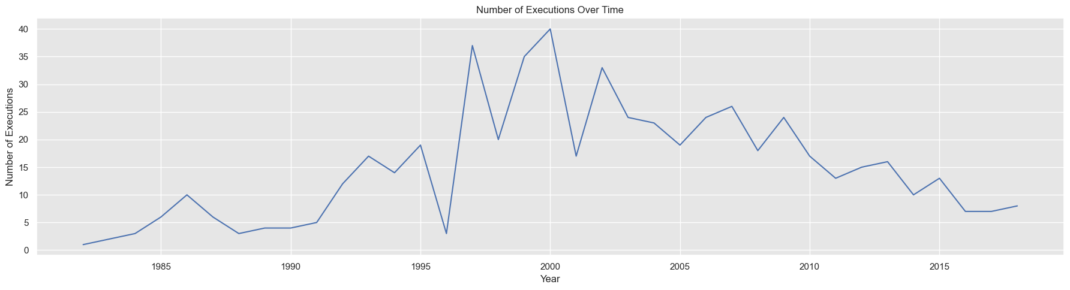
Number of Executions Over Time

Slide 7
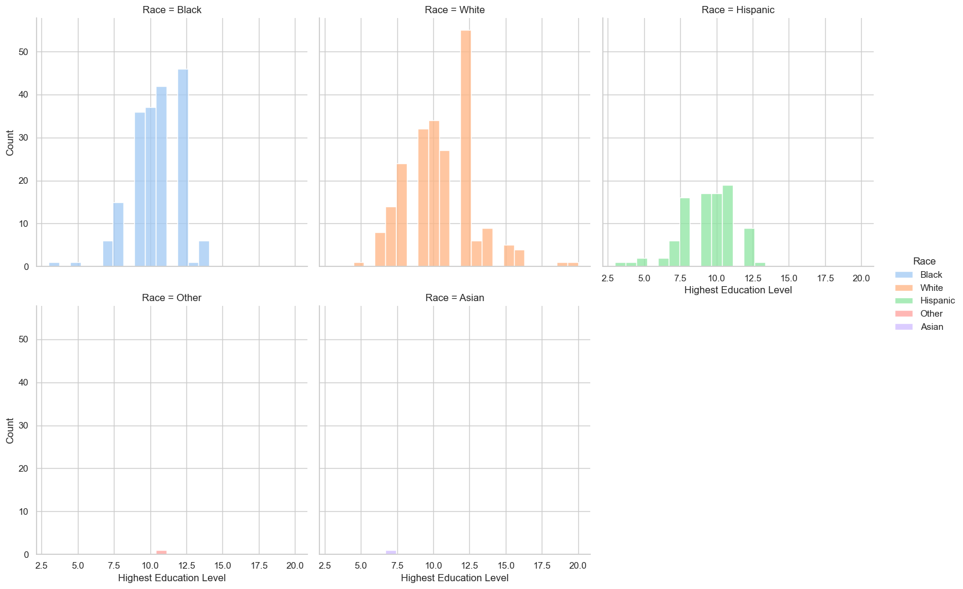
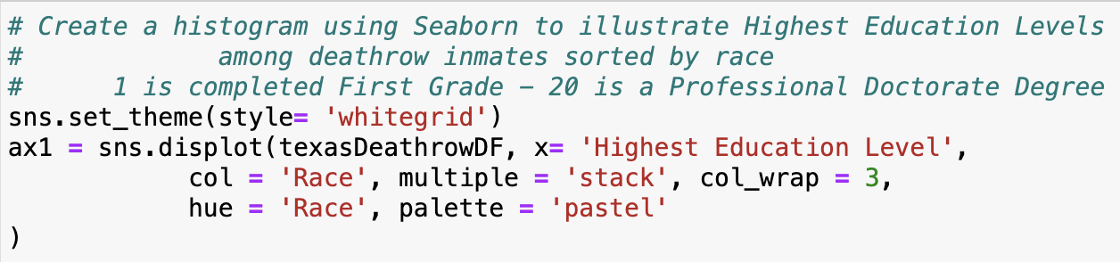
Highest Education Level
Only one death row inmate with a Doctorate Degree

Slide 8
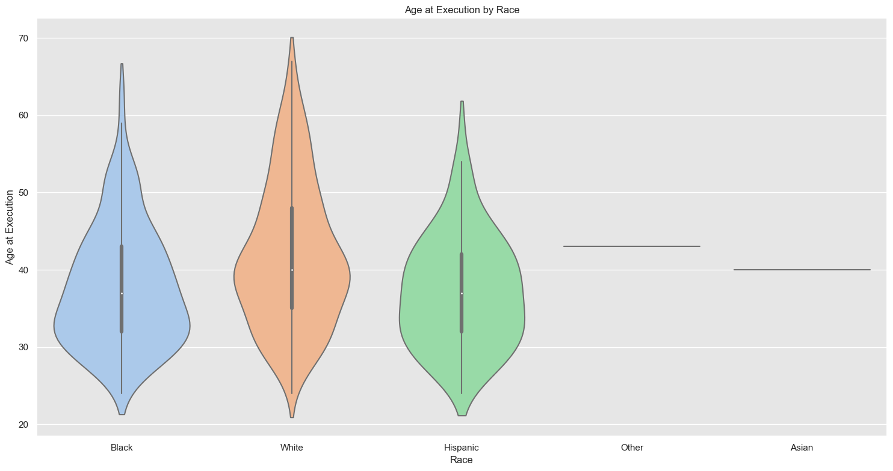
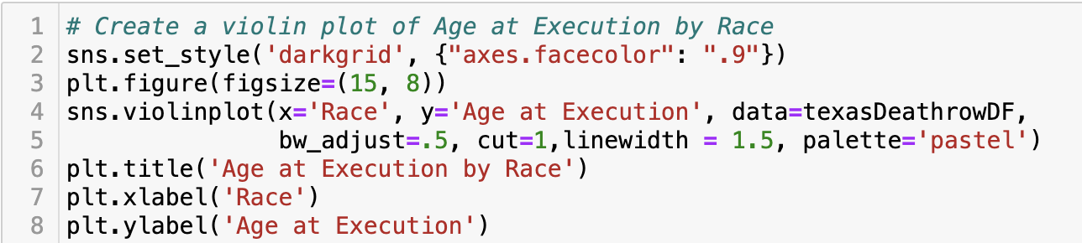
Age at Execution by Race
Interquartile range
Median
Outliers

Slide 9
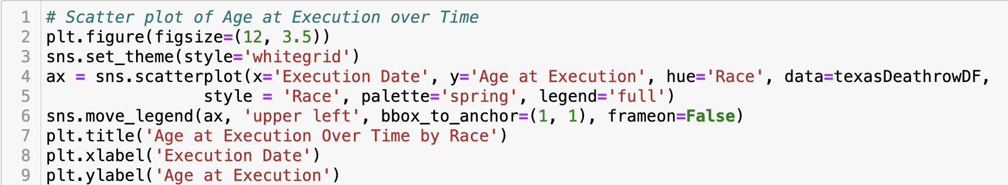
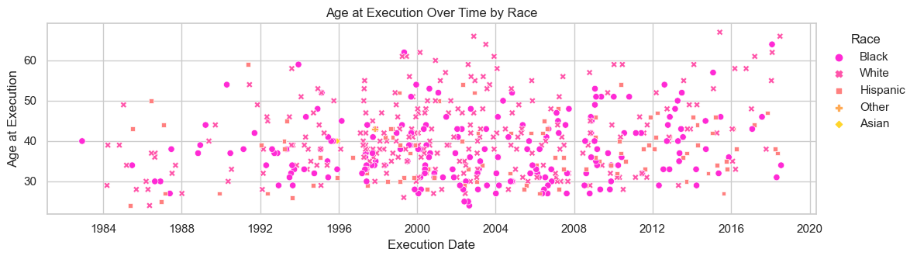
Age at Execution Over Time
Notice how the density of the markers mirrors the belly of the violin plot

Slide 10
And now, here’s Jason…

